Slide 1
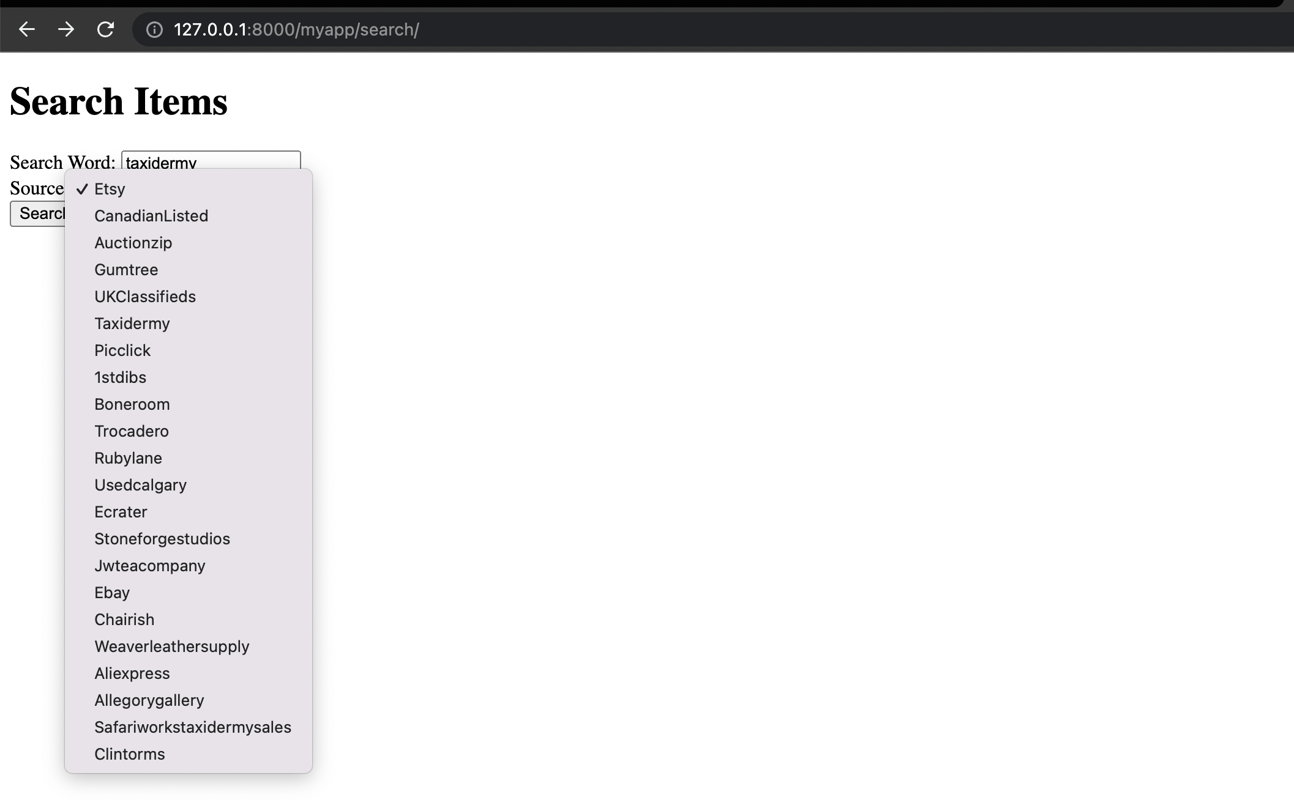
web-Page

Slide 2
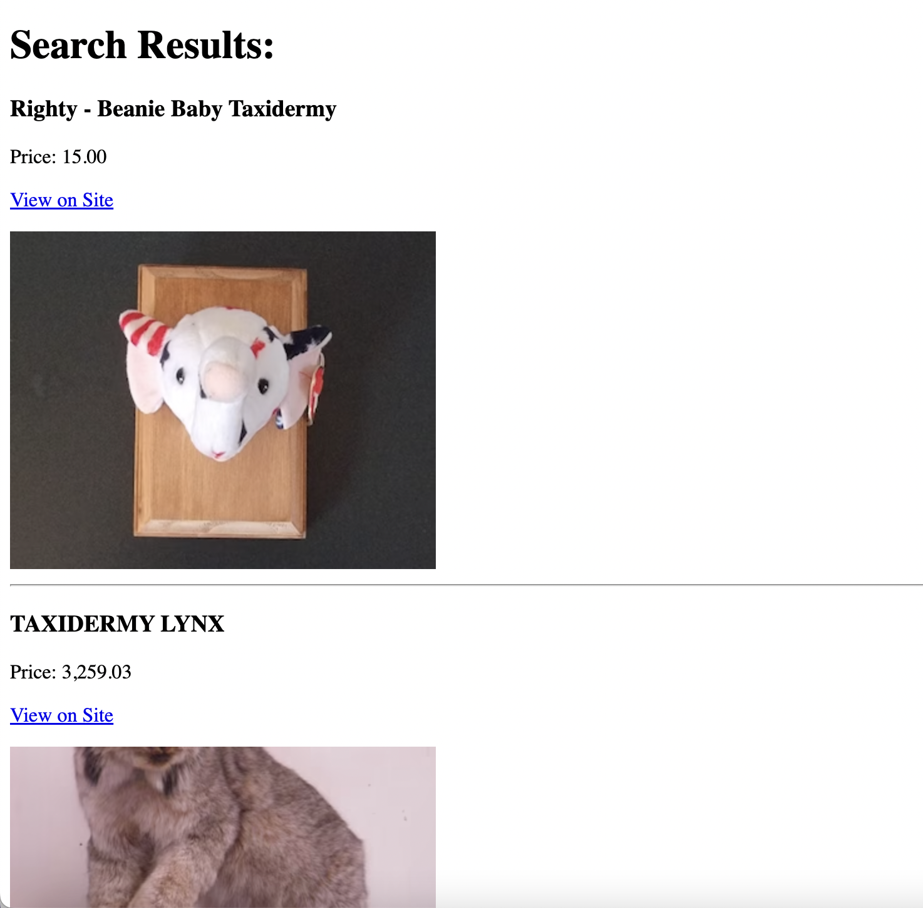
taxidermy-etsy

Slide 3
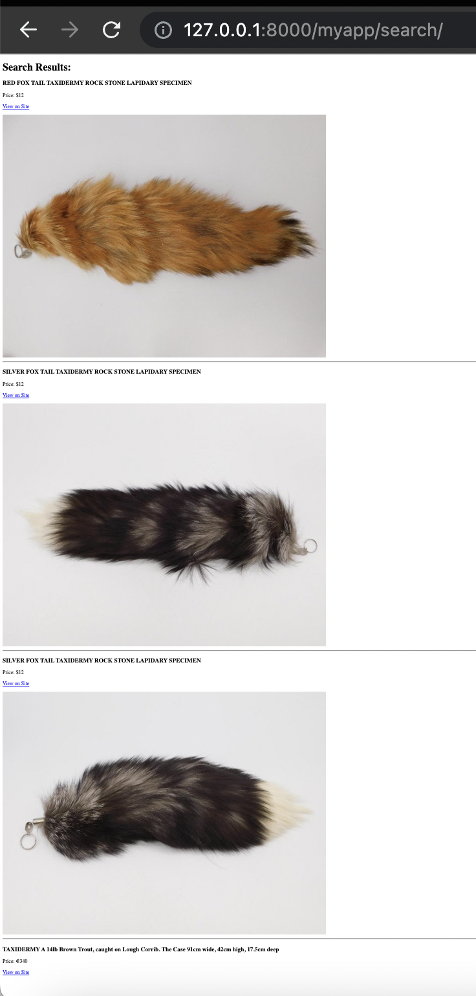
Taxidermy- auctionzip

Slide 4
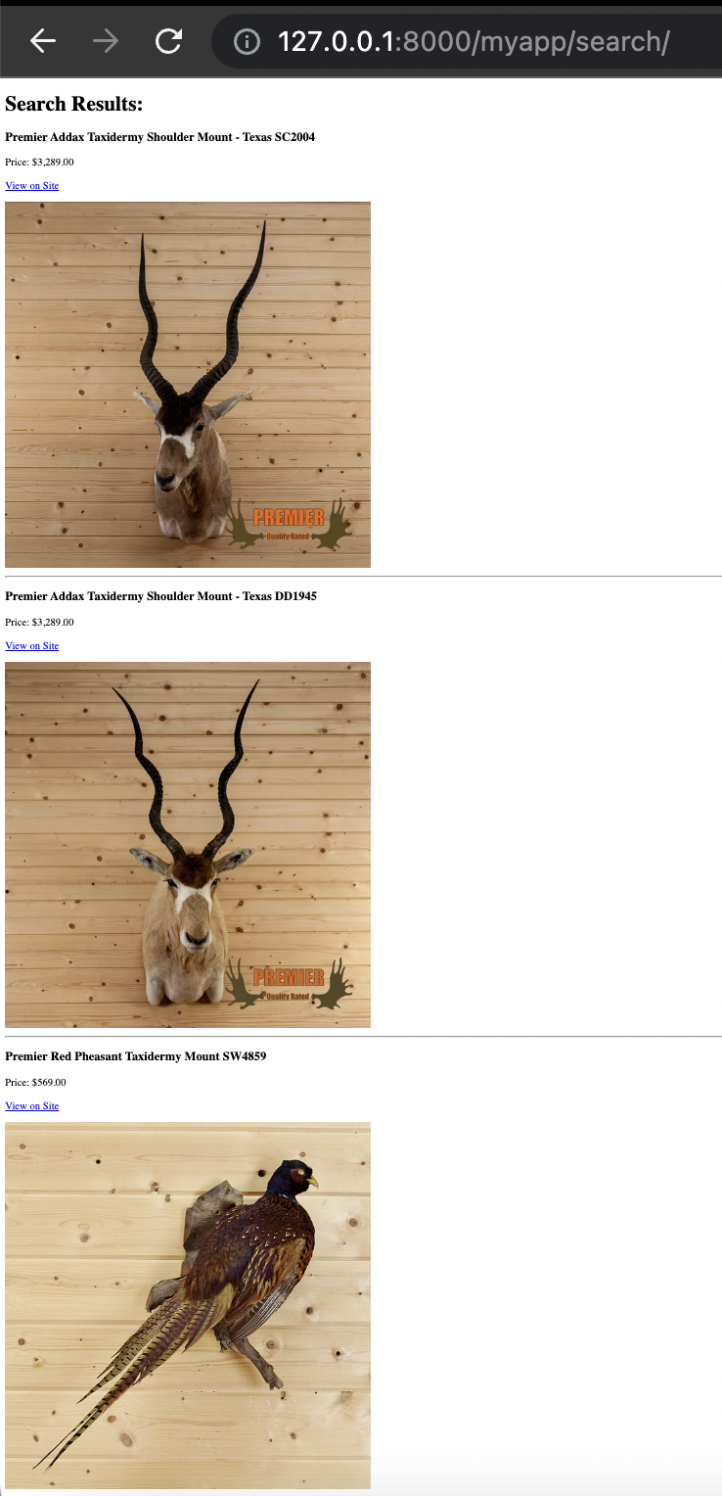
Taxidermy store

Slide 5
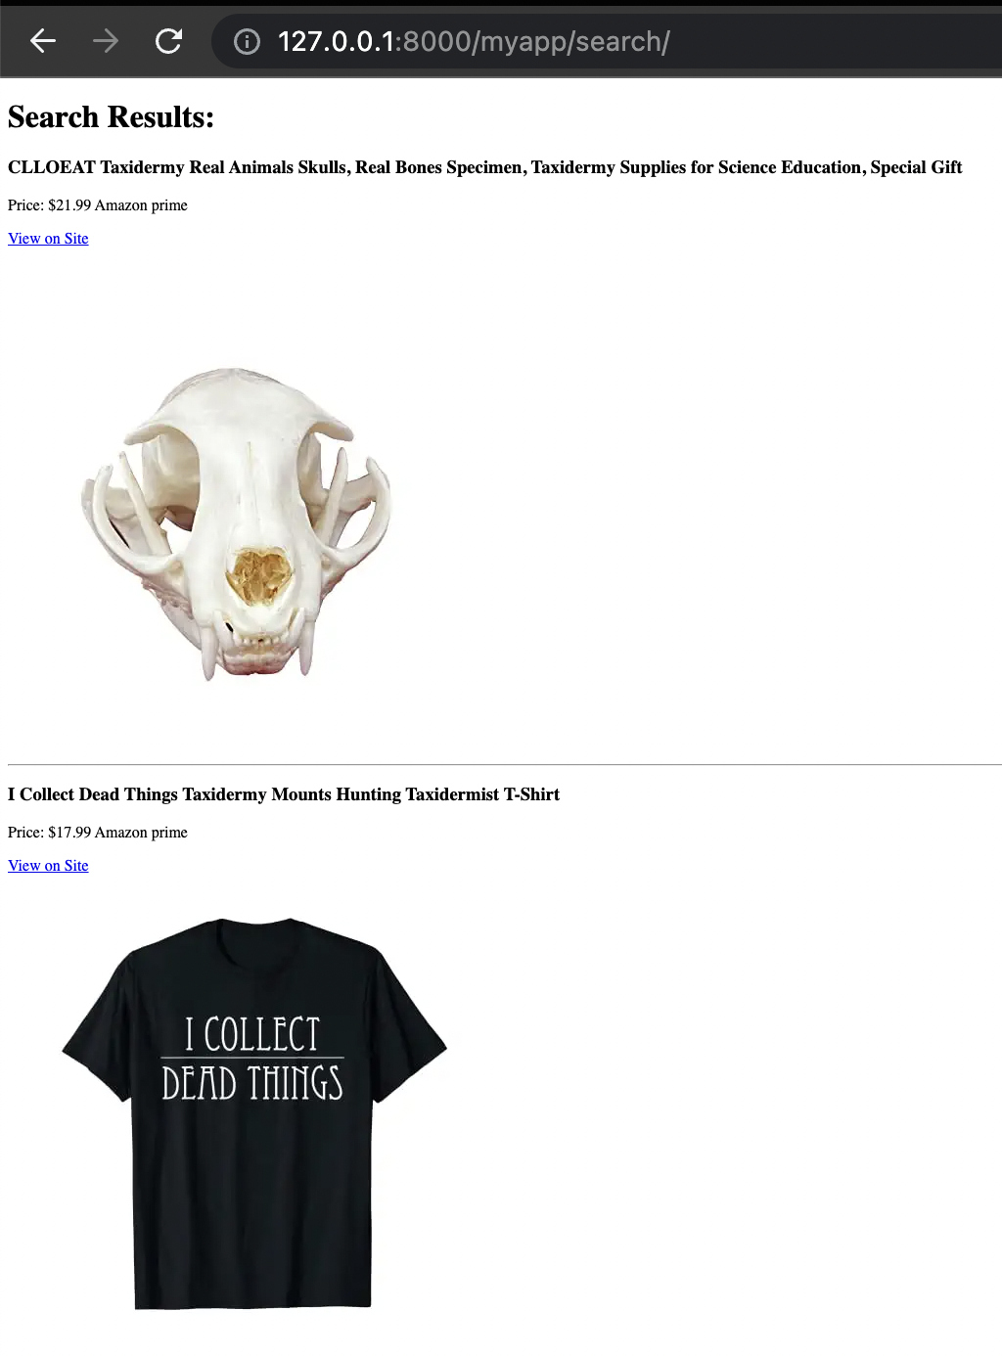
Taxidermy- picclick

Slide 6
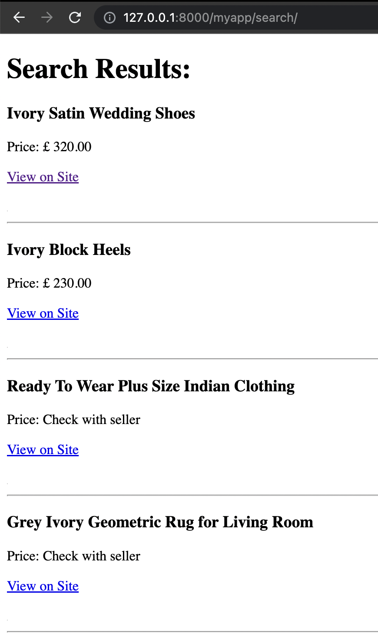
UK Classifieds

Slide 7
whole procedure
Django Project created: /Documents/Project
Application: /project/app
Added the app to Installed apps of the project
In View of app- the view function contains the logic to generate the results and return them as a response.
the results() function calls your Python code that generates the results and then returns a rendered HTML template (results.html) with the results variable passed to it.
Create a folder named templates to store the html files in it.
Create file URLs in the app folder
Add the newly created app URLs in the URLs of the project
Make sure that the current directory path is correct
Create the python file and add python code

Slide 8
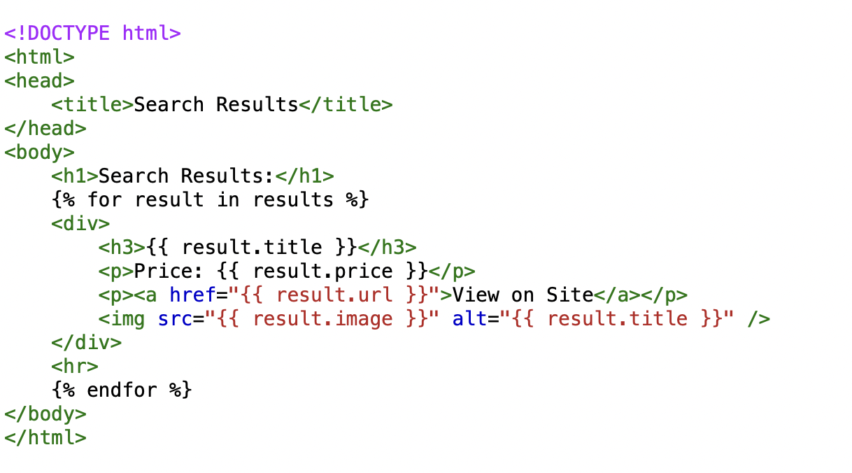
Results.Html

Slide 9
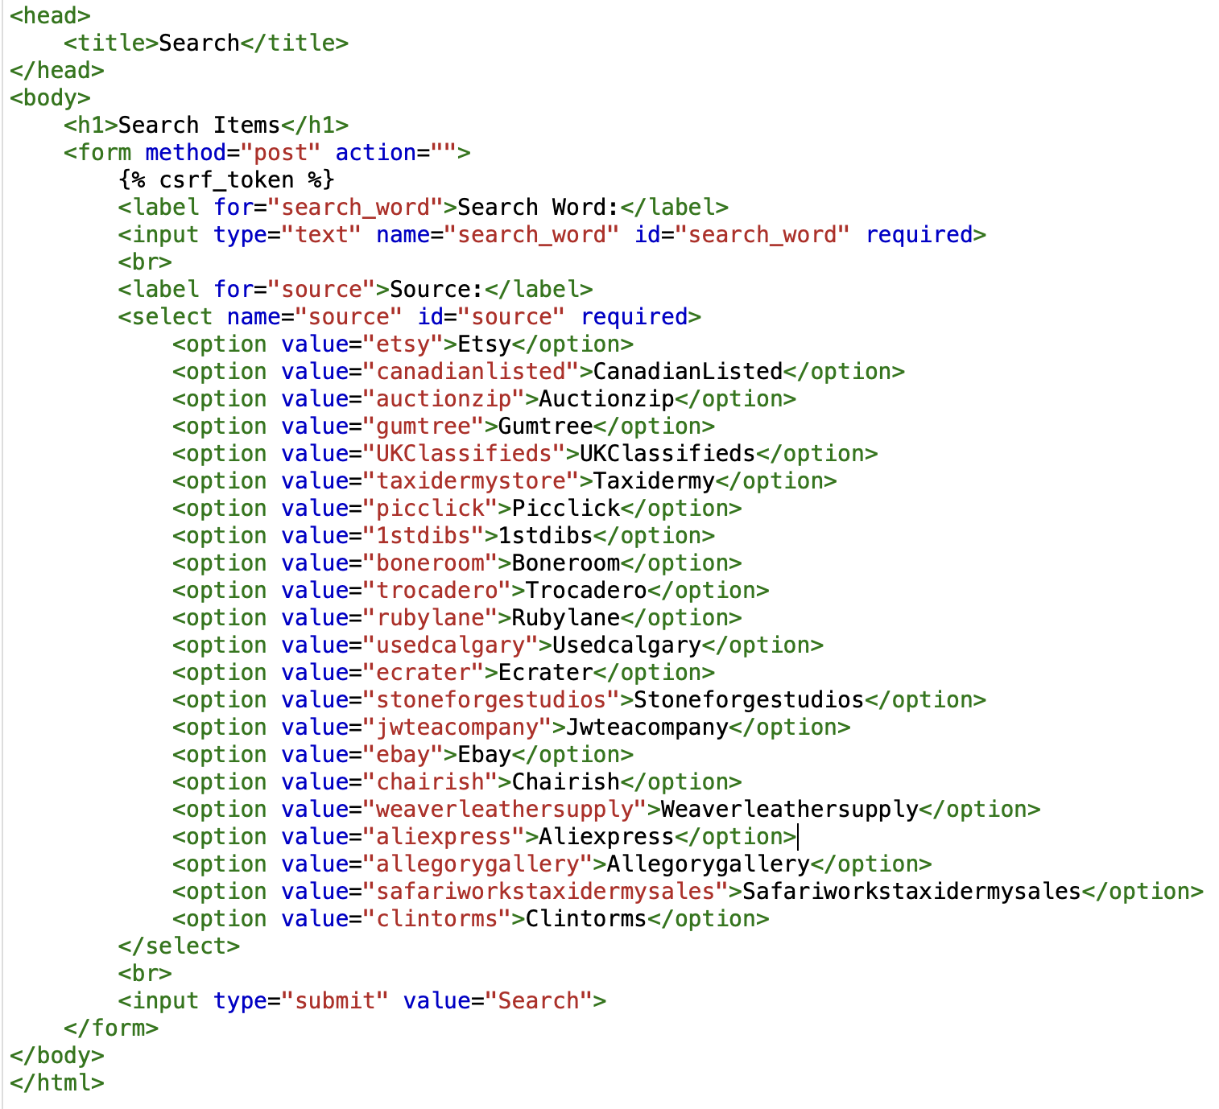
SEARCH.HTML

Slide 10
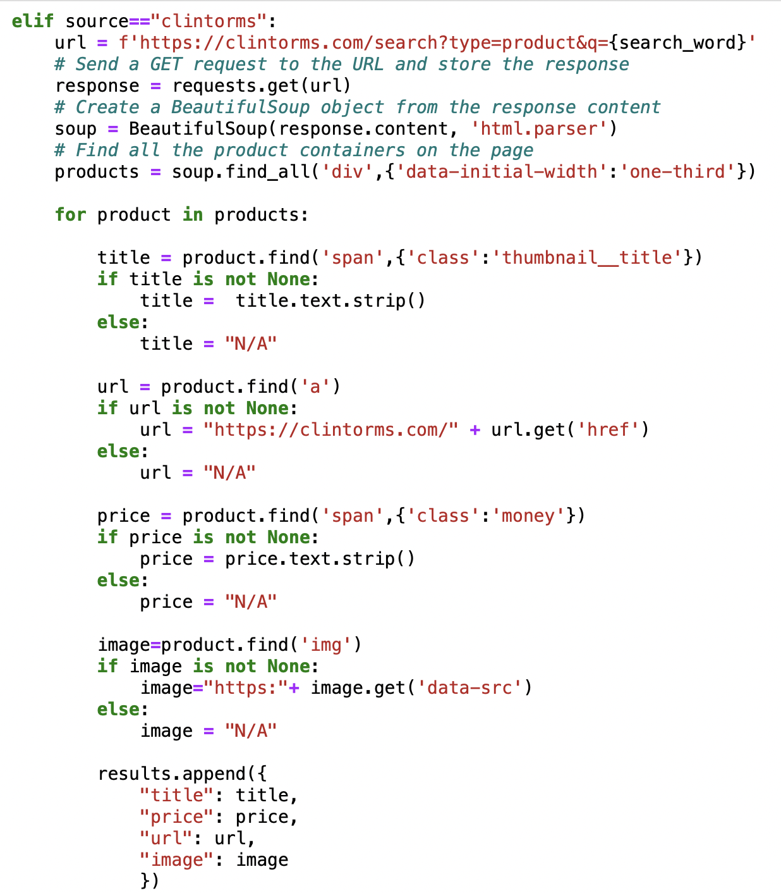
PYTHON CODE SNIPPET OF ONE WEBSITE

Slide 11
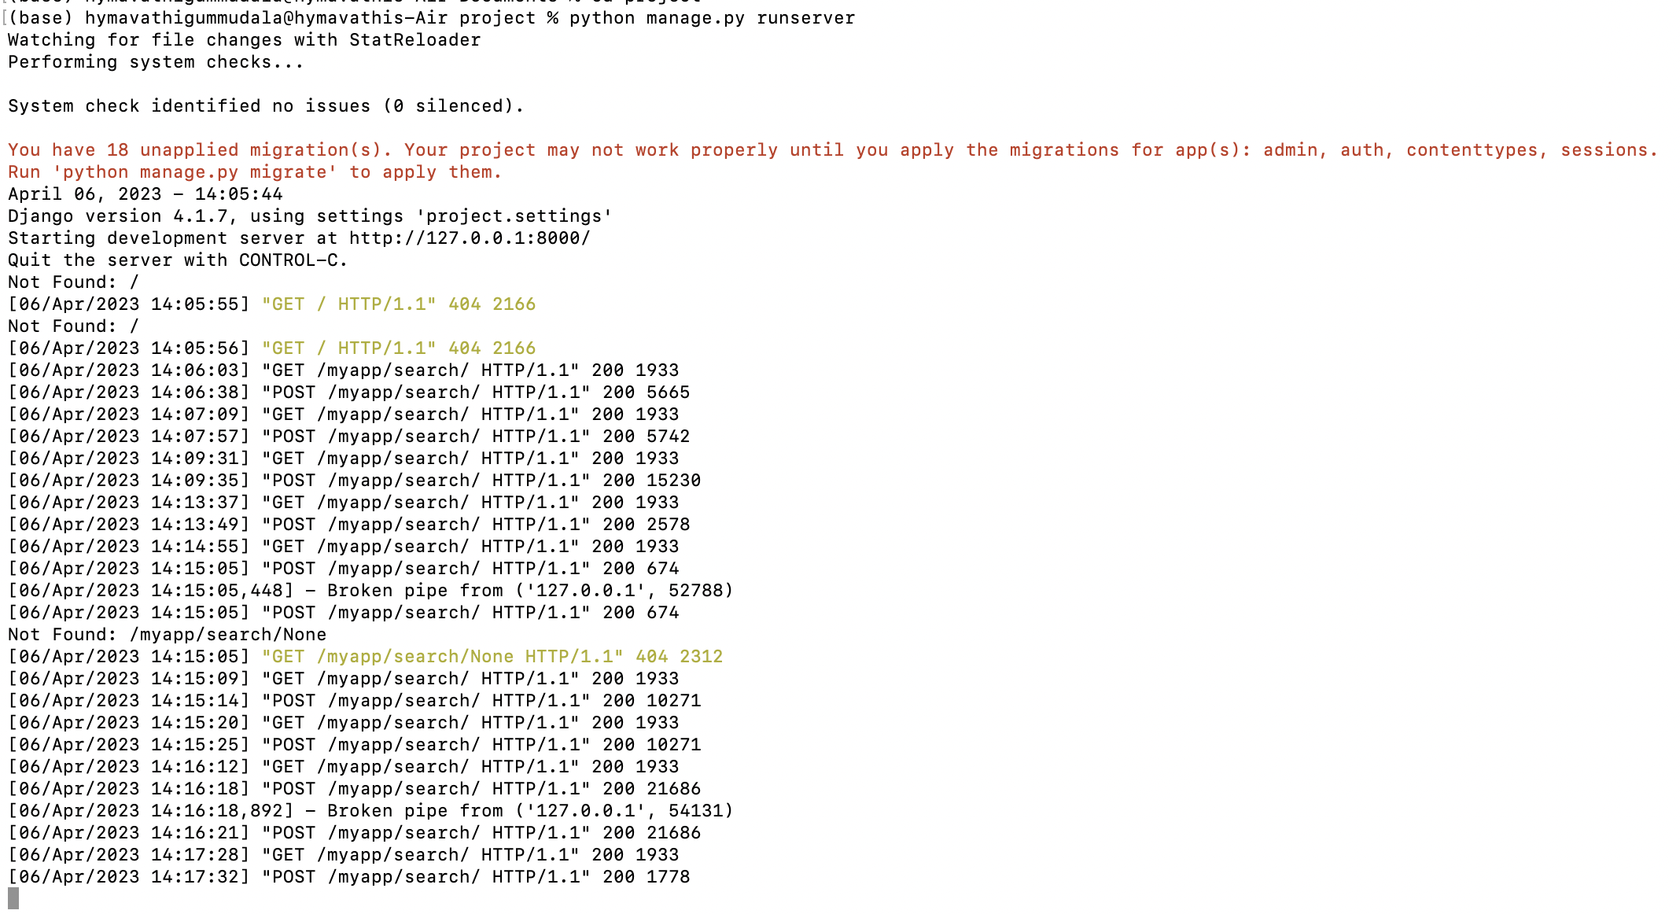
DJANGO TERMINAL SNIPPET

